Slide 1
Flexible Bed Update
Finance, Performance and Quality Committee Report
8th July 2025
Report by Dee Davidson, Lead Nurse Care Home Tactical Team
Report reviewed by Stephanie Mottram, Divisional Manager CHSC
Data support by Kathy Jennings, Performance & Intelligence Data Analyst, Strategic Planning and Transformation.
Data collection by Community Waiting Times Team.

Slide 2
Flexible bed-based model of care is an integral part of the D&G RCRP programme with the fundamental principle of providing the right care in the right place at the right time, supported by services tailored to meet individual needs.
Flexible bed based care and support is expected to be short term, usually up to 6 weeks, and will deliver step up, step down, planned respite and palliative / end of life care.
Flexible bed based care aims to ensure people’s needs are met in a homely setting as close to their own home as possible, when these needs cannot be met in their own home.
Flexible beds aim to support flow within the wider system
Flexible beds aim to reduce inpatient bed days where appropriate care and support can be delivered in a care home setting rather than hospital for a short period of time.
PERSON

Slide 3
Dispelling Myths – Flexible beds are:
Not an alternative to a community hospital / hospital bed. It is a different model of care and support where if a persons needs are unable to be achieved at home and where a hospital admission can be safely avoided (if not required) by achieving that care and support in a homely setting (Care Home).
Not taking away long term placement care home beds. The Flexible Bed Project has brought back into operation 24 care home beds that were not previously available. Flexible beds are enabling people to remain at home for longer – short term breaks allow people an appropriate level of support for a short period of time and ensure that people do not utilise a long term bed before it is actually needed.
Not a more expensive option. A Flexible Bed has a weekly cost of £1013.05 which is less than a weekly hospital stay. If the FB was not block purchased the bed would be purchased through a different route, it would not lie empty.
Not just used by people for planned respite. In the period evaluated 242 bed days utilised for planned respite in comparison to 454 step up bed days.

Slide 4
Progress
IJB direction issued to commission 31 Flexible Beds in 2024
Now 22 beds in commission.
  Goldielea - 5 beds (Dumfries South)
  Bankfoot - 1 bed (Mid & Upper Annandale & Eskdale)
  Belmont - 1 bed (Rhins)
  Cumloden - 1 bed (Machars)
  Cornwall Park - 1 bed (Machars)
  Merse - 3 beds (Stewartry)
  Munches - 2 beds (Stewartry)
  Queensberry - 7 beds (Mid & Upper Nithsdale)
  Thorneycroft - 1 bed (Rhins)
No FB in Dumfries North as the 2 non-speciality care homes in this locality did not express an interest in participating; however there are 5 FB’s in Dumfries South
No FB in Lower Annandale & Eskdale as neither of the 2 care homes in this locality expressed an interest in participating.

Slide 5
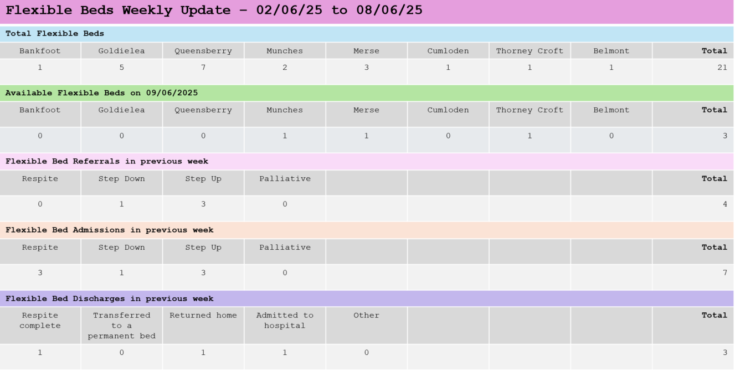
Monitoring & Evaluation
Ongoing evaluation in place with daily monitoring, weekly update and formal quarterly reports completed/to be completed
Community Waiting Times Team (CWT) co-ordinating role
Referral Standard Operating Procedure (SOP) in place
Weekly trouble shooting / update meetings with Care Home Managers
Regular Partnership / Provider Relationship meetings
Snap shot of FB’s in operation below:

Slide 6
103 people referred into Flexible Bed between 01/10/24 and 28/02/25

Slide 7
Referral data:
The 50.5% of people (52) who were not admitted during this period were for the following reasons:
bed no longer required
person did not meet the criteria
person accepted to a Flexible Bed but with an admission date booked for after the period analysed or for later in the year (planned respite)

Slide 8
Referral route of the 51 admissions 01/10/2024 - 28/02/2025

Slide 9
51 people admitted to Flexible beds between 01/10/24 and 28/02/25
Of note monthly average of 22 people are admitted to all Care Homes in D&G (excluding Flexible beds)

Slide 10
Total of 20 beds available for utilisation during this evaluation period
This is equal to 2389 bed day opportunities
Total of 1474 Bed Day opportunities utilised
The following could be argued:
a planned respite stay potentially avoids hospital admission or utilisation of long term placement beds in care homes before they are needed. This supports flow within wider system and aligns to ‘D&G Carers Strategy’
step down FB utilisation has allowed people to be discharged from hospital avoiding a longer stay in an inappropriate setting
step up bed stays include emergency respite, short notice breakdown in carer support, increase in frailty but not sick or requiring hospital admission

Slide 11
15% of all Flexible Bed admissions interviewed to understand the peoples journey.
2 case studies with some of the questions asked during interview.
Case study 1- Anne
76 year old lady
Main carer was son who passed away unexpectantly while caring for Anne.
Anne is assessed as having capacity (to be reassessed).
Unable to cook meals, needs assistance with washing and dressing, mobilises with a zimmer frame, needs help getting in and out of bed, unable to cope at home without care and no care available in the community at short notice. Walks with purpose during the night.
Q: What was to be the alternative to moving into a Flexible Bed?
A: ‘Hospital as no family nearby at that time’
Q: Were you worried about moving into a care home even for a short period of time?
A: ‘ I live in Lower Annandale & Eskdale but I was admitted to a care home in Mid & Upper Nithsdale. I was very anxious as I do not know this area and have no friends here. It is longer distance for my family to visit me. However, I am very well cared for here, I have made friends and the staff are wonderful. I love the food and my bed is very comfortable. The staff encourage me to do as much for myself as possible because they know I will be going home and they keep reminding me of this. I would not have been as nervous if I was able to go to Lydiafield or Annan Court care homes as they are close to my home and I am very familiar with both homes as I visit many people there over the years so know the buildings and some people that live there.
Q: When do hope to return home?
A: Very soon if my family can support. I really do hope I can get some help at home but if not I would like to try and mange on my own. If I am not able to go home I would be happy to move into a care home now that I know that people are very kind and caring. I would even consider moving here (Lower Annandale & Eskdale).
Case study 2 – Mary
88 year lady
Lives at home with son and daughter in law. Daughter in law was a carer in the past and does all care and support for Mary.
Mary is immobile but can get from bed to chair and toilet with some help from daughter. Daughter not copying with the full time responsibility of care and Mary’s needs are increasing. Mary has full capacity. Mary asked the son to call social workers to discuss moving into a care home although Mary did not want to.
Q: What was to be the alternative to moving into a Flexible Bed?
A: ‘Moving into a care home full time but my social worker suggested that I plan some respite instead and allow my son and daughter a period of rest. I was told it would be a break for me too. We were all hoping that a break would ease the burden. I am a terrible burden on my son and wife’.
Q: Were you worried about moving into a care home even for a short period of time?
A: ‘ I was terrified as I had heard so many awful things about care homes. I was very scared and deeply sad that my life has now come to this. However, I moved in for 2 weeks before Christmas and had a lovely stay. I made a friend (Joan) who lives here full time. This home is very far from my sons’ house but this is a break so they have gone away and wouldn’t be visiting me anyhow. The staff are just wonderful and nothing is too much. They know what I can do at home and remind me, all the time, that they need to carry out care the same way my daughter in law does so that she can continue when I go home. After my first stay for respite my daughter in law was a different person so I told them to book another break. My social worker was very helpful and I am now on my second stay. I get to see Joan again which is just lovely. I know at some point I will have to move into a care home but will stay at home as long as I can. When the time comes I wish to move in here (different home team area) as although I live in Dumfries I now know the staff here now and have a friend so I will choose here rather than move somewhere I don’t know’. ’

Slide 12
Questions?

